Slide 1
RESUME BUILDING
A Workshop Organized by the Department of Humanities

Slide 2
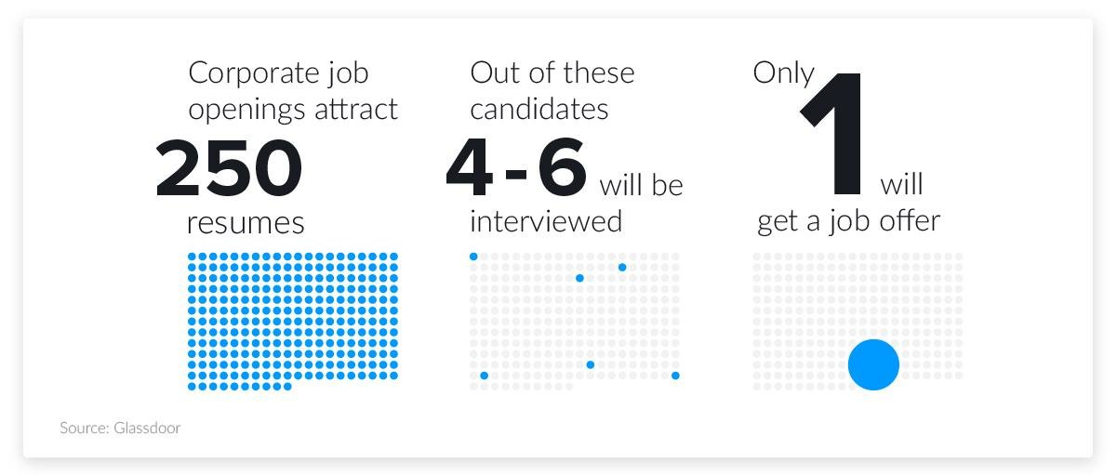
On average, each corporate job offer attracts 250 resumes. Of those candidates, 4 to 6 will get called for an interview, and only one will get the job. (Glassdoor)

Slide 3
Job Search, Hiring, Recruiting & Interviews
1 in 6 candidates who applied for a job was asked for an interview. (Jobvite 2017 Recruiting Funnel Benchmark Report)
Recruiters take an average of 6 seconds to scan a resume. (The Ladders)
87% of recruiters use LinkedIn to check candidates. (Jobvite Recruiter Nation Report 2016)
The average amount of time to find a job is 24 weeks.
(Bureau of Labor Statistics, November 2020)

Slide 4
The Job-Search Statistics All Job Seekers Should Know
60 percent of jobs are found through networking — not online
75 percent of resumes are rejected before they reach the hiring manager
77 percent of recruiters rely on LinkedIn
54 percent of employers have rejected candidates based on their social media profiles
A professionally written resume boosts your earning potential by 7 percent

Slide 5
FOUR PRINCIPLES OF RESUME
CONNECTED – Name, Qualification, Skills, Experience
CONCISE- Less is more
CHARISMATIC- Compelling charm that inspires devotion
CLEAN- Show not tell

Slide 6
TOP 5 RESUME MISTAKES:
Spelling and grammar errors
Missing email and phone information
Using passive language instead of “action” words
Not well organized, concise, or easy to skim
Not tailored to the position or industry

Slide 7
RESUME LANGUAGE SHOULD BE:
Specific rather than general
Active rather than passive
Written to express not impress
Articulate rather than “flowery” Fact-based (quantify and qualify)
Written for people who scan quickly

Slide 8
DON’Ts Of resume
• Abbreviate
• Use a narrative style
• Use slang
• Include a picture
• Include age or sex
• List references
• Start each line with a date
Use personal pronouns (such as I)

Slide 9
DOs
Be consistent in format and content
Make it easy to read and follow, balancing white space
Use consistent spacing, bold, and capitalization for emphasis
List headings (such as Experience) in order of importance
Within headings, list information in reverse chronological order (most recent first)
Avoid information gaps
Be sure that your formatting is translated properly if converted to a .pdf

Slide 10
The following list of action verbs are typically used in resumes:
Administered Analysed Collected Completed Communicated Conducted Coordinated
Created Designed
Developed
Directed
Evaluated
Increased
Led
Managed
Observed Operated Organized Oriented Prepared Sampled
Started Supervised Taught
Trained

